Slide 1
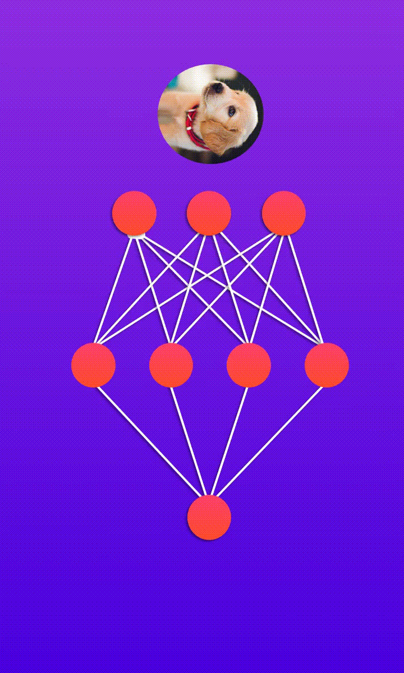
SPS Data science Seminar
Booz Allen Hamilton External
Kaimi Kahihikolo
07 December 2019

Slide 2

About me
Former SPS President
BS Astrophysics
Data Scientist at Booz Allen Hamilton
A fortune 500 consulting company
Offices all around the world
Local AI/ML lead developer
Transitioning to Industry
Physics and Astronomy coursework will develop a diverse, and transferable skillset desirable to many businesses and disciplines.
Let me know if you have any questions about this process!
How to get in touch:
Email: kahihikolo_kaimi@bah.com
GitHub: kaimibk
LinkedIn: kaimibk

Slide 3

Agenda for today
Section 1: Introductions
Section 2: defining data science
Section 3: Regression & Optimization
Lunch Break
Section 4: Neural Networks
Section 5: Logistic Regression
Section 6: Classifying handwritten digits
Main take away from this seminar
You won’t walk away some data science rock star
Get familiar with some of the concepts
Maybe you’ll see them again
Get more comfortable with coding

Slide 4
Defining Data science
What is it and why should you care?

Slide 5

Defining Data Science | What is it?
What is it?
Data Science in of itself is a nonsensical term…is there science without data?!
Primary Goal: leveraging tools and algorithms, with the goal of analyzing data to discover the “truth”
Including,
Machine Learning (ML)
Artificial Intelligence (AI)
Statistical Analysis
Data Visualization
Some Popular Applications in industry

Slide 6
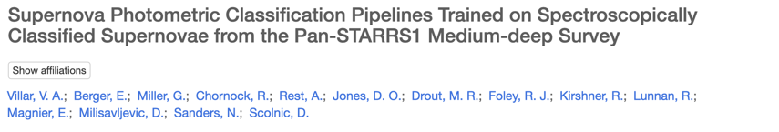
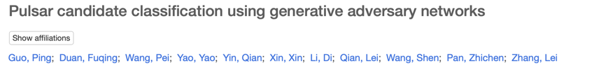
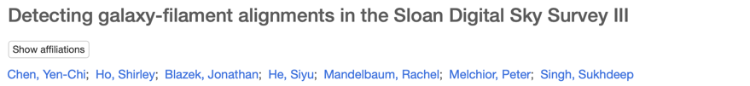
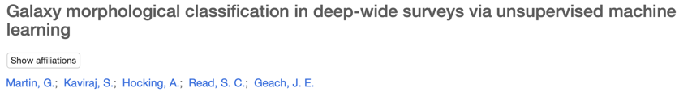
Defining Data Science | Applications in astronomy
Why should you care?
As astronomers and physicists, all you do is analyze data!
Large amounts of very complicated data
Learning various techniques will allow you to supercharge your analysis efforts, to undertake groundbreaking research.
Many Astronomers/Physicists are unaware of these advances
This gives you the opportunity to really assist your peers!
Random selection of papers from ads

Slide 7
Defining Data Science | What is AI/ML?
AI/ML is getting computers to program themselves. If programming is automation, then machine learning is automating the process of automation.
Let the data do the work instead of people. AI/ML is the way to make programming scalable.
Traditional Programming:
Data and program is run on the computer to produce the output.
Machine Learning:
Data and output is run on the computer to create a program. This program can be used in traditional programming.
TWO MAIN BRANCHES: Supervised and unsupervised learning

Slide 8


Defining Data Science | Supervised Learning
Describes techniques where both independent and dependent variables/features are known
The task is to learn the mapping,
In other words, show how the independent and dependent variables are related
Again, two types arise,
Regression (Will we do this)
Colloquially known as “fitting a model to data”
The most common form analyses in Academia
Classification (and this too!)
Determining the “label” of a measurement
Learn the correlation between labels and data
OR

Slide 9
Defining Data Science | Unsupervised Learning
Describes techniques where both independent and dependent variables/features are unknown
The tasks are essentially equivalent to the supervised learning ones (regression/classification), except
The output of the mapping is never observed
The most common type of learning in the world
Most data sets are unlabeled, and uncleaned
Again, two types arise,
Density Estimation
Estimate the probability density function of a random variable
Clustering
Divide population into smaller groups
Kind of like classification!

Slide 10
Regression & optimization
If you can understand how to fit a line to data, you understand 90% of machine learning and artificial intelligence

Slide 11
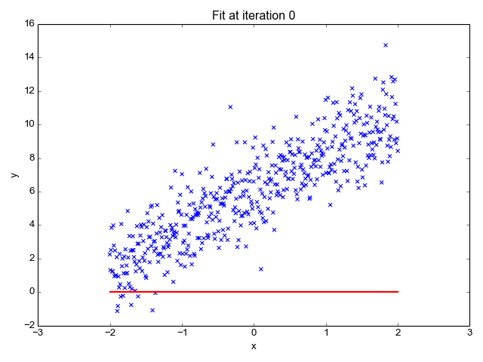
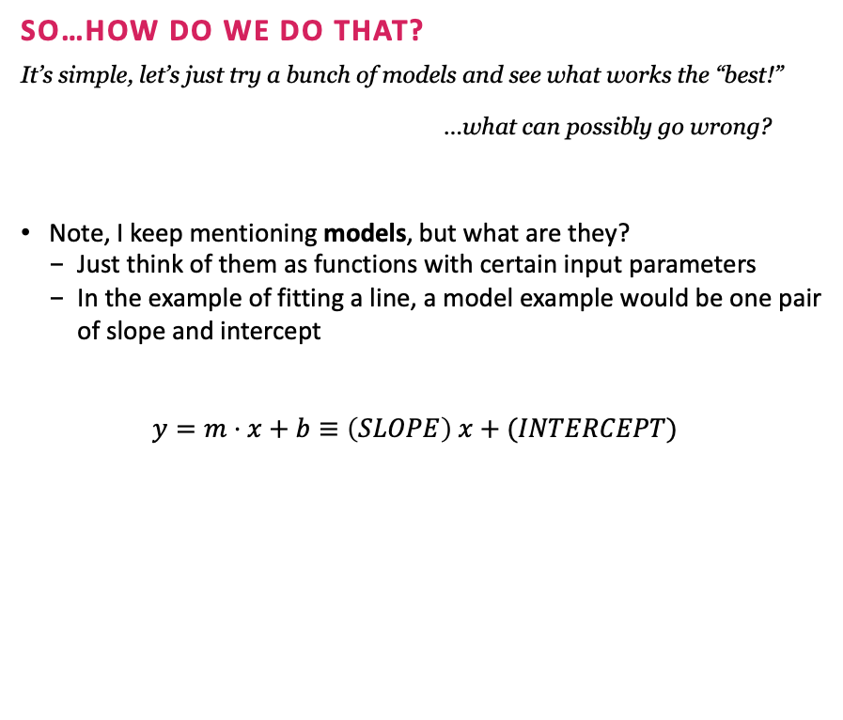
Regression & Optimization | Regression Review
Goal of regression
Learn the mapping between independent and dependent variables, like fitting a line!
Most statistical analyses in physics revolves around some form of regression (linear, polynomial, non-parametric, etc.)
The only type of analyses you will do in your labs! So pay attention!
So…how do we do that?
It’s simple, let’s just try a bunch of models and see what works the “best!”
…what can possibly go wrong?
Note, I keep mentioning models, but what are they?
Just think of them as functions with certain input parameters
In the example of fitting a line, a model example would be one pair of slope and intercept
$$y=m⋅x+b≡\left(SLOPE\right) x+(INTERCEPT)$$

Slide 12
Exercise #1:
Which model fits the best?
Description:
By manually playing around with the slope and intercept of a line, visually try to pick out the “best” fitting model.
Notebook link:
https://colab.research.google.com/drive/1TId8MwV9ekYLfbfrk4Xed6wvXrCsOWuY
Duration:
10 min
Note: File > Save A Copy... To not loose your changes

Slide 13
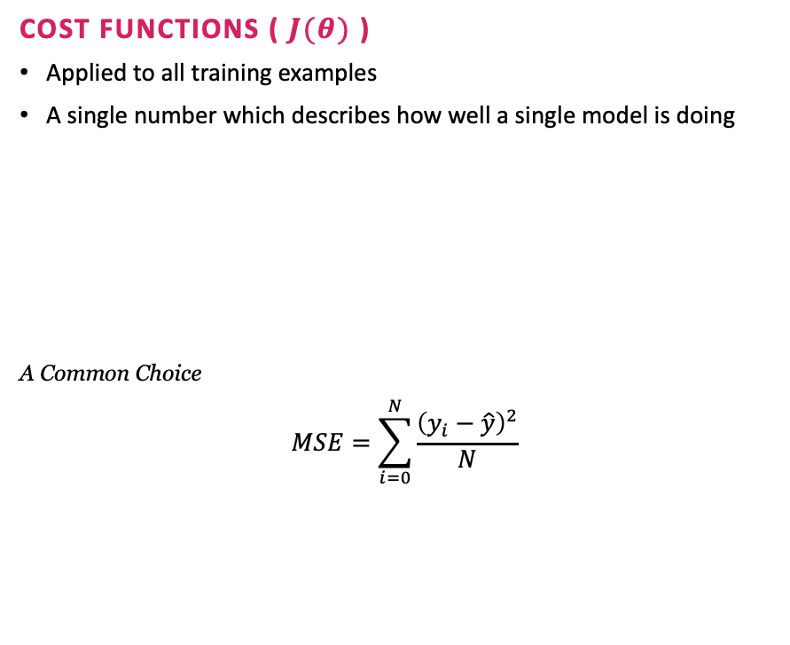
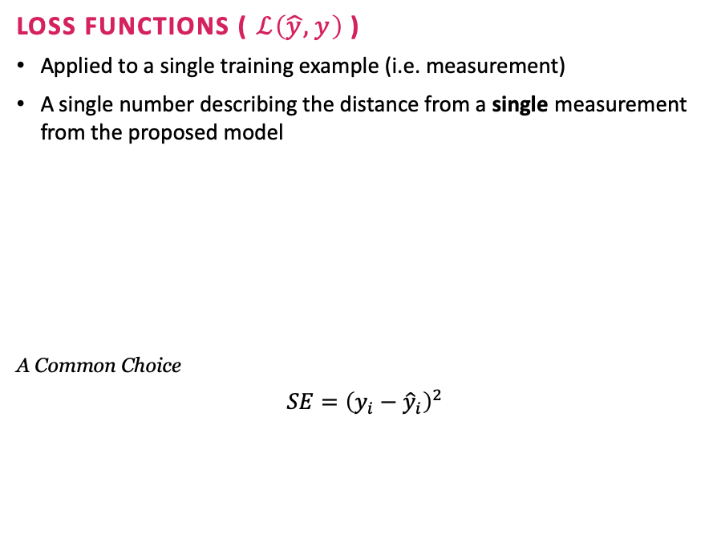

Regression & Optimization | Defining ”best”
So…how do we define if a model is “good?”
This introduces the idea of cost functions and loss functions, which both indicate the performance of a model.
Loss Functions ( $ℒ\left(\hat{y}, y\right)$ )
Applied to a single training example (i.e. measurement)
A single number describing the distance from a single measurement from the proposed model
A Common Choice
$$SE={\left(y_{i}−{\hat{y}}_{i}\right)}^{2}$$
Cost Functions ( $J(θ)$ )
Applied to all training examples
A single number which describes how well a single model is doing
A Common Choice
$$MSE=\sum_{i=0}^{N}{\frac{{\left(y_{i}−\hat{y}\right)}^{2}}{N}}$$
$y_{i}:$single measurement
$\hat{y}$: model “guess”
N: number of training examples

Slide 14
Exercise #2:
loss/cost functions
Description:
By manually playing around with the slope and intercept of a line, use the loss/cost functions to pick out the “best” fitting model.
Notebook link:
https://colab.research.google.com/drive/1ShyhsVuz06Zk4anH5ljdl1UWvw7H1dUY
Duration:
10 min

Slide 15

Regression & Optimization | Optimization
What is optimization?
As the name implies, it optimizes something
In our specific application, we would like to find the optimal parameters which extremize the scalar cost function.
How Does it Work?
There are numerous techniques for optimization, all with different spatial/temporal performances and use cases
The most brute force method is a grid search
Try every possible combination of parameters, and retrospectively choose the best combination of parameters
Obviously, this isn’t a good thing when we have to learn lots of parameters…
For more, see my notes HERE.

Slide 16
Exercise #3:
simple Optimization
Description:
Use SciPy to find the optimal slope and intercept of our model automatically.
Notebook link:
https://colab.research.google.com/drive/15EB5P7B-ZfZbVBEpHraetUxJxh5dms0c
Duration:
10 min

Slide 17
Neural Networks
Like a brain…I think?
Notes:
https://skymind.ai/wiki/neural-network

Slide 18
Neural Networks | Physical Inspiration
A human Neuron
Neurons internally perform information processing on electrical action potentials (while information between neurons is mostly chemical interactions).
Pre-synaptic action potential depolarizes a synaptic terminal.
Calcium ion channels sensitive to voltage changes open and allows calcium to enter.
Neurotransmitter is released.
Neurotransmitter binds to post-synaptic receptors.
Ions enter post-synaptic cell (Evoked Post-Synaptic Potential (EPSP))

Slide 19
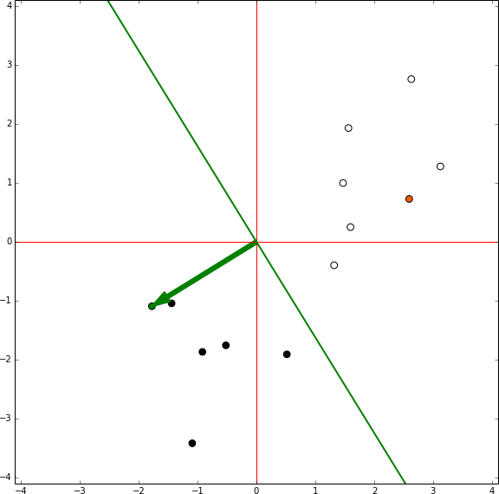



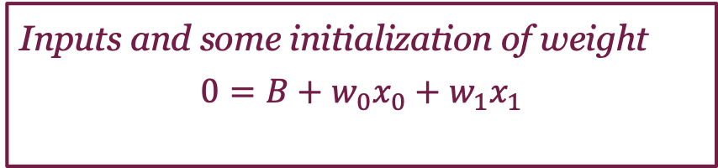

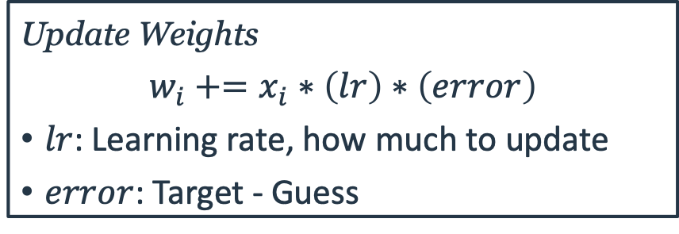

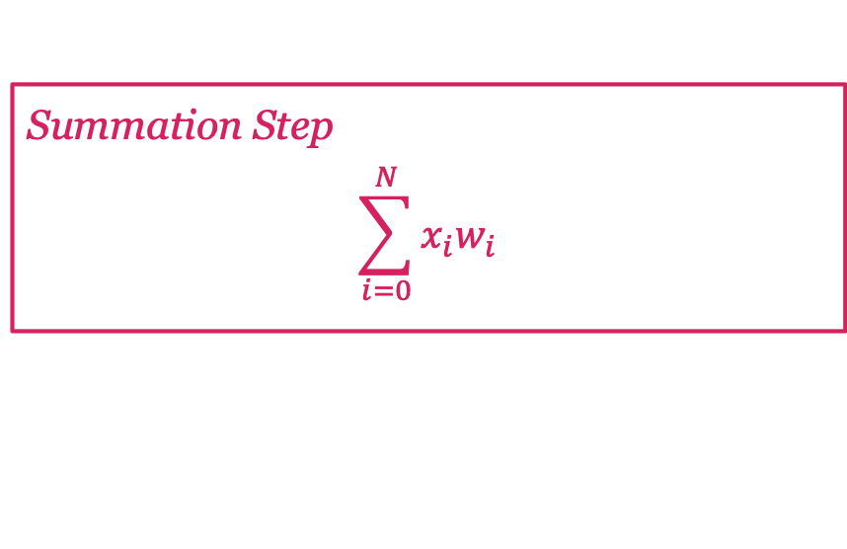
Neural Networks | The Perceptron
The simplest Neural Network
+1
$$x_{0}$$
$$w_{0}$$
NEURON
(NODE)
$$y$$
Input
Output
$$x_{1}$$
$$w_{1}$$
-1
Step 1
Step 2
Step 3
Step 4
There are problems with this algorithm!
Falls a part for XOR cases / nonlinear functions
What happens if we strap a bunch of these together?
Inputs and some initialization of weight
$$0=B+w_{0}x_{0}+w_{1}x_{1}$$
Summation Step
$$\sum_{i=0}^{N}{x_{i}w_{i}}$$
Activation Step
Convert the sum to a binary output, such as +1 or -1.
Lots of other choices
Corresponds to whether or not the "neuron" will fire.
Update Weights
$$w_{i}+=x_{i}∗\left(lr\right)∗\left(error\right)$$
$lr$: Learning rate, how much to update
$error$: Target - Guess

Slide 20
Exercise #4:
The Perceptron and Hyperparameters
Description:
In this exercise, you will use a perceptron to classify different colored dots on a canvas, and observe how adjusting various parameters influence the learning.
Notebook link:
https://colab.research.google.com/drive/1hvF6JDMzEBemdwwYkz3z0jaj-6b5MQZi
Duration:
20 min

Slide 21
Neural Networks | Diagrams
Let’s just strap a bunch of them together!
This overcomes many of those problems, however introduces many other problems
Slower training time
without GPU support
Quickly overfits
Approximates the function too well
To learn more about this, click HERE!
Lack of interpretability
What is happening in all those layers/neurons?!
Needs a LOT of data
Thanks to significant advances by the scientific community and hardware limitations, neural networks have flourished anyway!

Slide 22





Neural Networks | The workflow
When training machine learning models, it always follows the same workflow:
Get your data, and if required, preprocess.
Split your data into training and validation sets.
Used for evaluating out-of-sample performance to prevent overfitting.
Define a set of hyperparameters and models to optimize.
Train your model and identify optimal parameters.
Evaluate the model performance.
We will see this in action in the next exercise

Slide 23
Logistic Regression
It’s raining cats or dogs!?
Notes:
https://edorado93.github.io/2018/09/07/Logistic-Regression-with-a-Neural-Networks-Mindset-9b5526c2ed46/
https://towardsdatascience.com/logistic-regression-using-python-sklearn-numpy-mnist-handwriting-recognition-matplotlib-a6b31e2b166a
https://medium.com/@randerson112358/python-logistic-regression-program-5e1b32f964db

Slide 24

Logistic Regression | What is it?
Classification algorithm
Despite the name ”regression,” logistic regression is an algorithm used for classification purposes.
Recall classification refers to the process of determining the “label” of a measurement.
Think cat vs dog as an example of binary classification.
Logistic regression returns the probability that an input vector maps to a particular class.

Slide 25
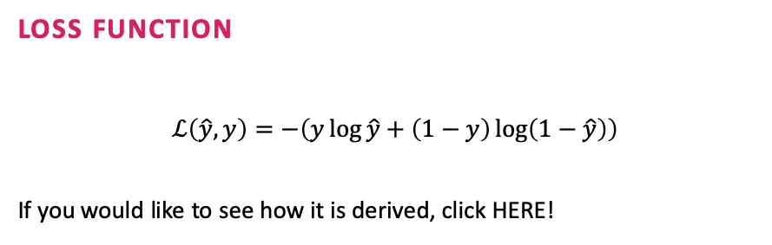
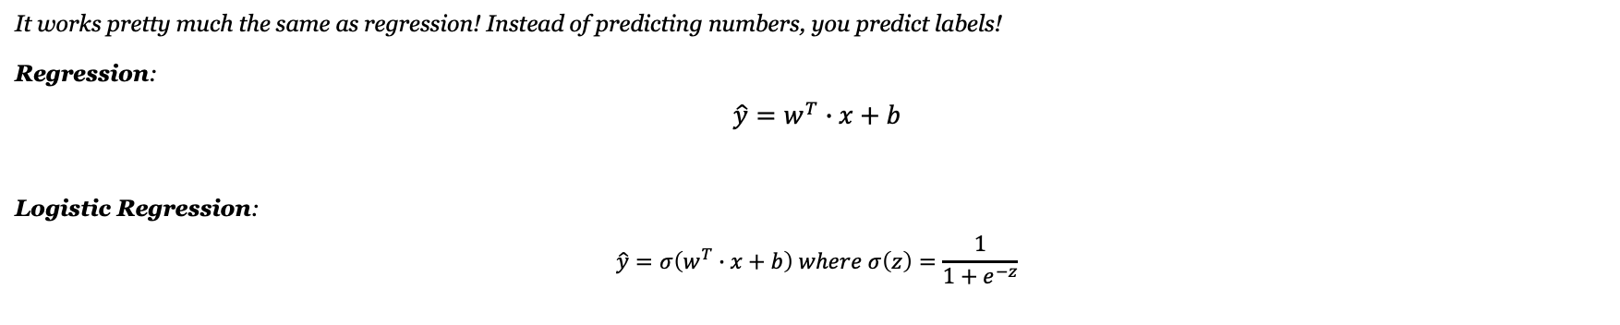
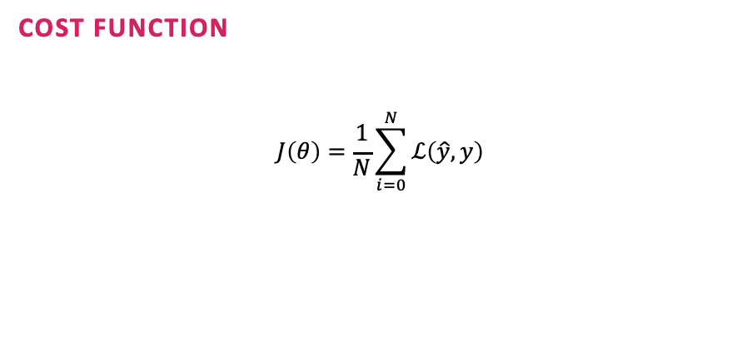
Logistic Regression | How does it work?
It works pretty much the same as regression! Instead of predicting numbers, you predict labels!
Regression:
$$\hat{y}=w^{T}∙x+b$$
Logistic Regression:
$$\hat{y}=σ\left(w^{T}∙x+b\right) where σ\left(z\right)=\frac{1}{1+e^{−z}}$$
Loss Function
$$ℒ\left(\hat{y}, y\right)=−\left(y\log{\hat{y}}+\left(1−y\right)\log\left(1−\hat{y}\right)\right)$$
If you would like to see how it is derived, click HERE!
Cost Function
$$J\left(θ\right)=\frac{1}{N}\sum_{i=0}^{N}{ℒ\left(\hat{y}, y\right)}$$
So…pretty much the same…
we just (1) pass it through an activation function and (2) use a different loss function…that is pretty much all of AI/ML

Slide 26
Do it yourself!
Making your own neural network to understand handwriting!
Notes:
https://towardsdatascience.com/logistic-regression-using-python-sklearn-numpy-mnist-handwriting-recognition-matplotlib-a6b31e2b166a
https://makeagif.com/gif/neural-network-taking-flattened-image-as-input-l75Isv

Slide 27
Do it yourself! | The Problem
The Data
In this example, we will have access to 1797 images of various handwritten digits. Here are some examples,
Each image is 8x8 pixels
For a dimensionality of 64
The Goal
Utilize logistic regression to automatically determine to number in the image!

Slide 28
Exercise #5:
Classifying Handwriting
Description:
Utilize logistic regression to distinguish numbers from hand written digits. Here you will see for yourself the layout of a data science project.
Notebook link:
https://colab.research.google.com/drive/1FxS61wOiHPF7kFCE9nLHXqGn6GijXLTF
Duration:
30 min

Slide 29
Exercise #6:
Do it again, all by yourself!
Description:
Utilize your choice of model to distinguish different types of flowers from crude measurements.
Notebook link:
https://colab.research.google.com/drive/1LwbnOs0pNOKNVlLY0_s4W8Z47ZjKWasO
Duration:
No limit. Make sure to look back at the previous exercise for assistance.

